Slide 1


SOCIAL BUZZ DATA ANALYSIS

Slide 2


Today's agenda
Project recap
Problem
The Analytics team
Process
Insights
Summary

Slide 3

Social Buzz is a fast growing technology unicorn that need to adapt quickly to it's global scale. Accenture has begun a 3 month POC focusing on these tasks:
An audit of Social Buzz's big data practice
Recommendations for a successful IPO
Analysis to find Social Buzz's top 5 most popular categories of content
Project Recap

Slide 4


Problems
Scaling Challanges:
Over 100000 posts per day
Data Complexity:
36,500,000 pieces of content per year!
Resources Constraints:
Only 200 tech staffs
IPO Preparation:
Completion of an IPO next Year

Slide 5



ANDREW FLEMING
Chief Technology Architect
The Analytics team
MARCUS ROMPTON
Senior Principal
SAMRAT SAHA
Data Analyst

Slide 6
Process
1
Data Understanding
2
Data Cleaning
3
Data Modelling
4
Data Analysis
5
Uncover Insights

Slide 7

Insights
16
1897
JANUARY
UNIQUE
CATEGORIES
REACTIONS TO "ANIMAL" POSTS
MONTH WITH
MOST POSTS

Slide 8
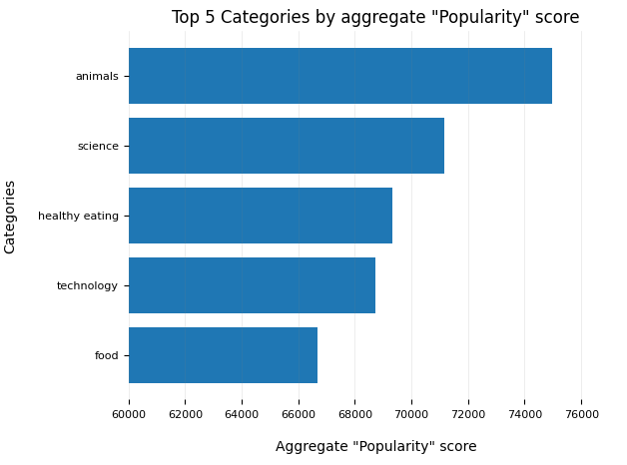

Slide 9
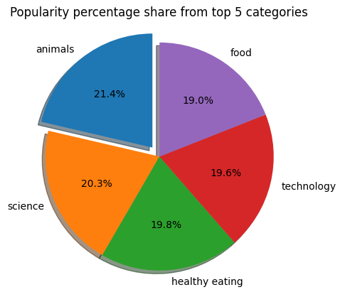

Slide 10

ANALYSIS
Animals and science are the two most popular categories of content, showing that people enjoy "real-life" and "factual" content the most.
INSIGHT
Summary
Food is a common theme with the top 5 categories with "Healthy Eating" ranking the highest. This may give an indication to the audience within your user base. You could use this insight to create a campaign and work with healthy eating brands to boost user engagement.
NEXT STEPS
This ad-hoc analysis is insightful, but it's time to take this analysis into large scale production for real-time understanding of your business. We can show you how to do this.

Slide 11

Thank you!
ANY QUESTIONS?

